Slide 1

Hackathon Goals: Build, Present, and Inspire
Be creative and play to your strengths
Functional prototype/MVP
No restrictions for technology
Companion app or expand ours
More backend focus with designs
We're open to your proposals!
Can be customer facing solution or supply chain oriented
Presentation - Sell your product and idea
What - Solution overview
How - Architectural diagram (not the focus, explain more how it should be)
Demo – Show that your idea is working
Roadmap – Future improvements, scalability
3 min pitch + 3 min Q&A 1-2 persons

Slide 2

EcoCart AI
4M1L - Niklas Wichter, Lenny Herold, Nick Xu, Jan Pluta , Noah Held

Slide 3
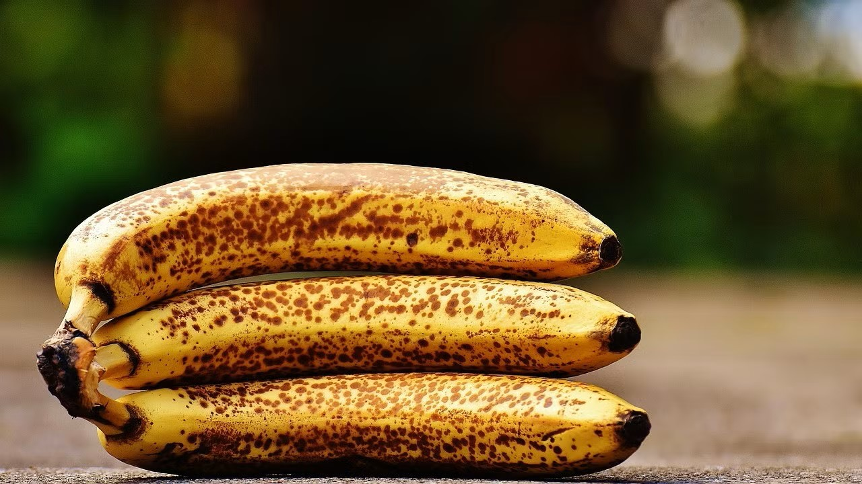
Problem
80% food waste reduction by PIC NIC, consumer main sources of food waste
PIC NIC offers healthy, carbon saving recipes, but consumers still tend to consume carbon intense animal products
making food
Solution
Chatbot to offer recipes to the customer
Point System points for buying perfectly imperfect, more carbon friendly meals

Slide 4
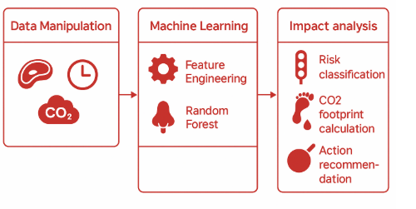
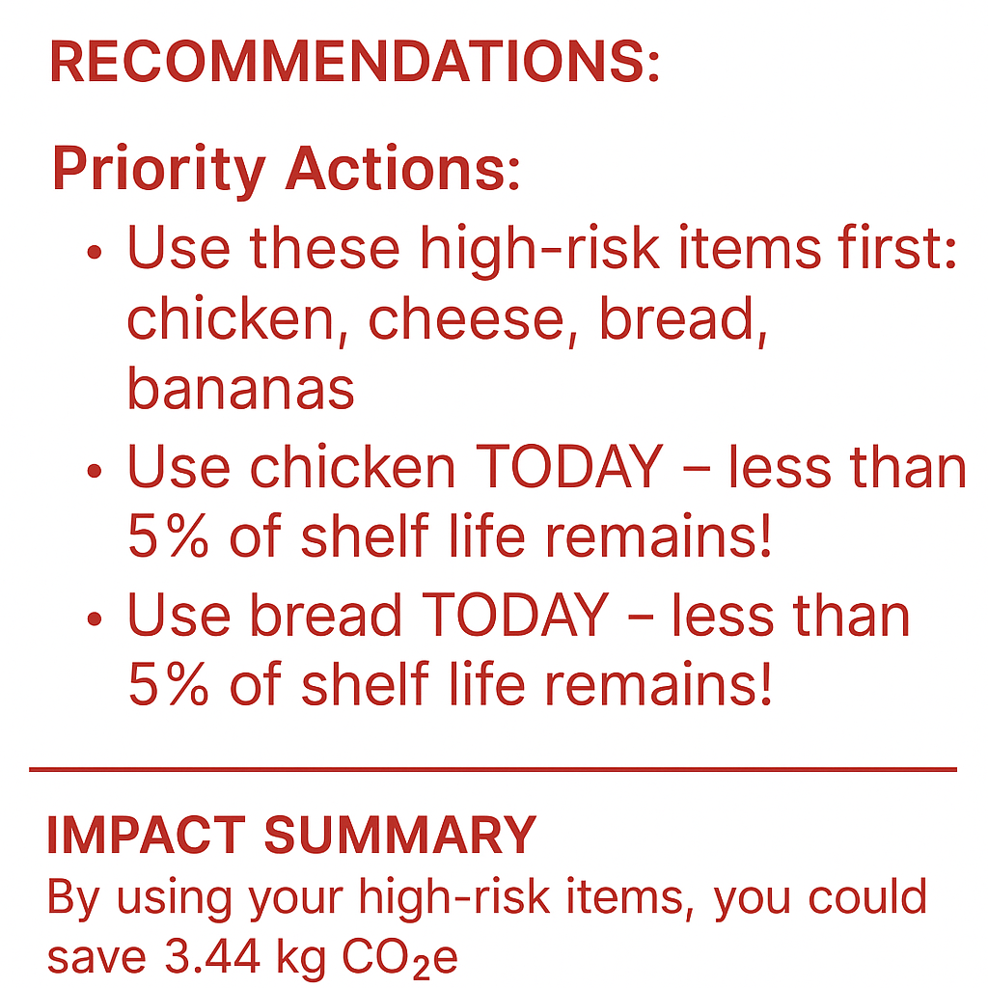
Data-Science
Model Output
Training accuracy: 0.88
Testing accuracy: 0.78
Risk Distribution:
High: 4
Medium: 1
Low: 2
Sensitive for high risk

Slide 5
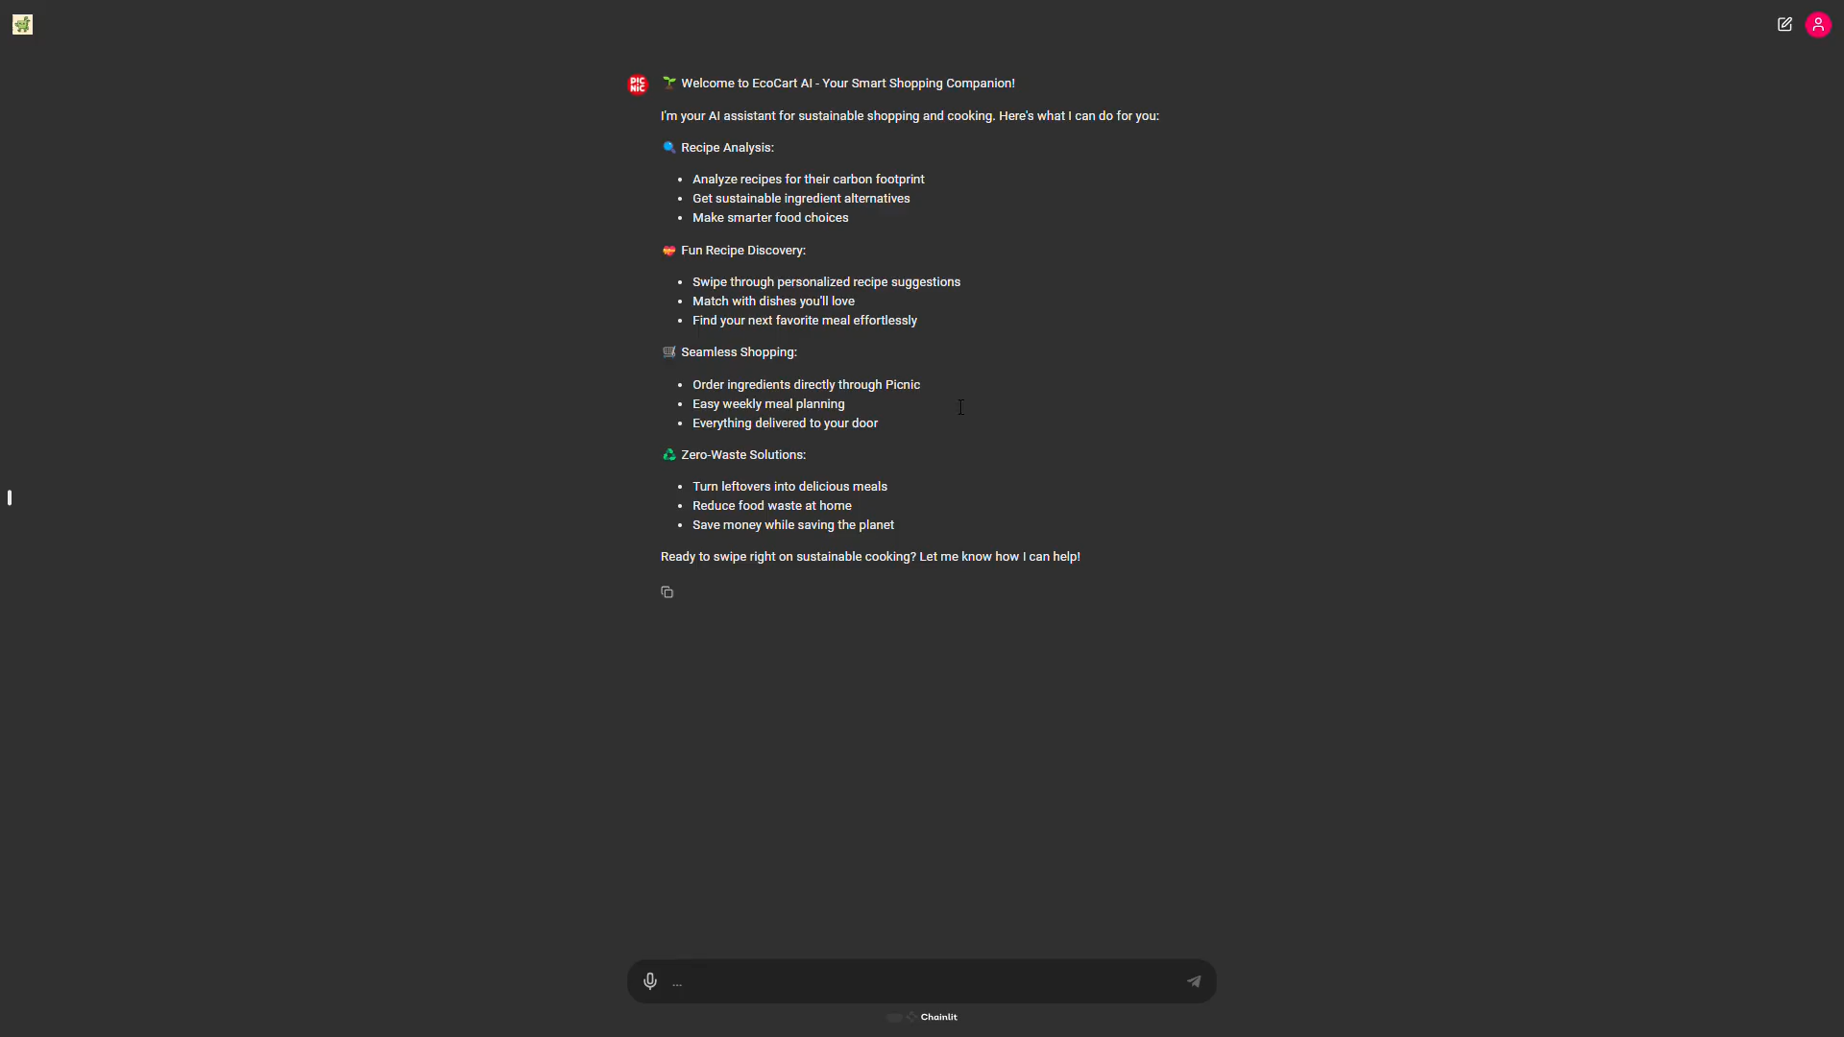
Tech Demonstration

Slide 6
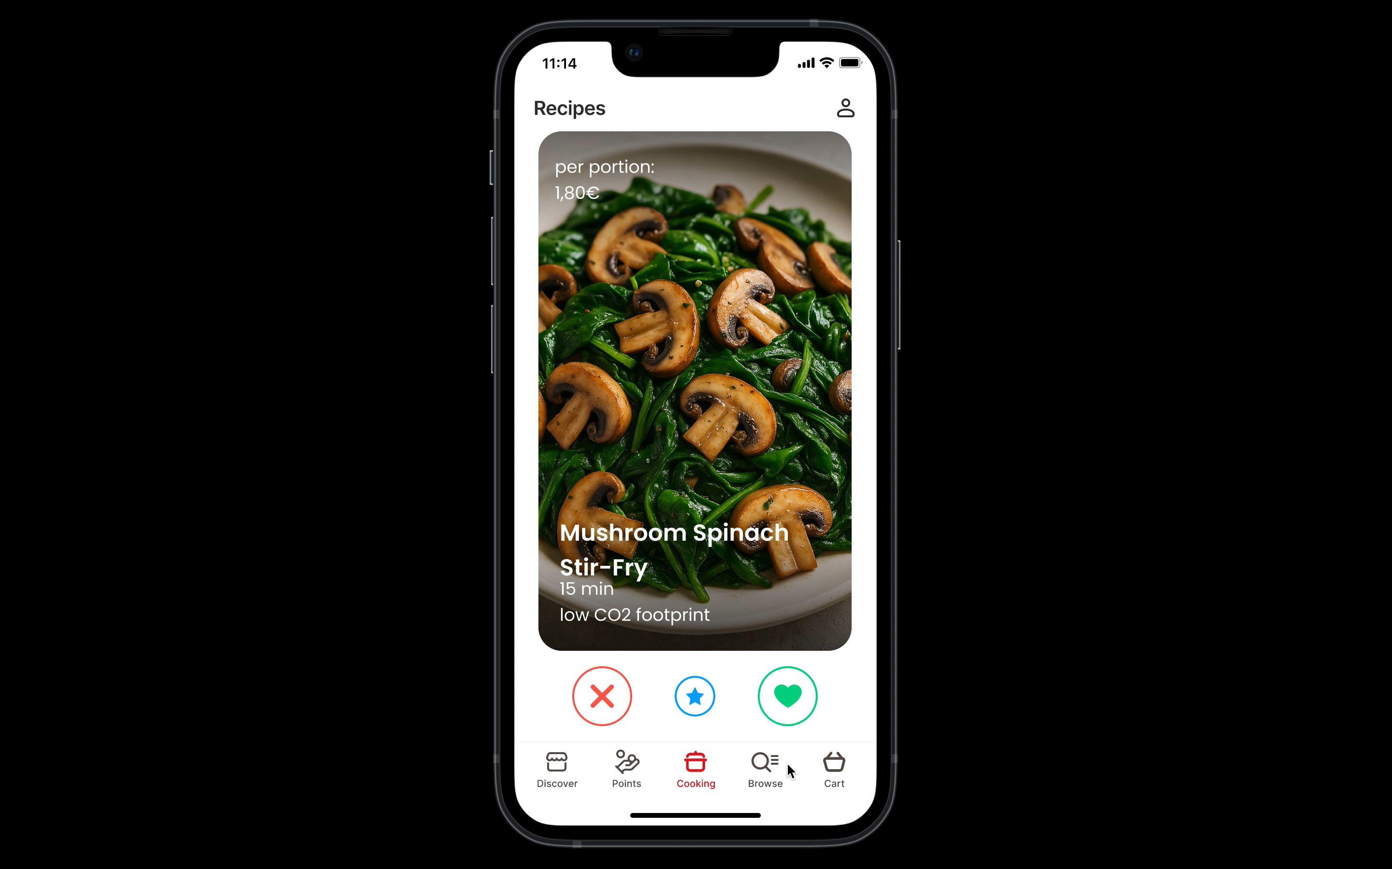
Tech Demonstration

Slide 7

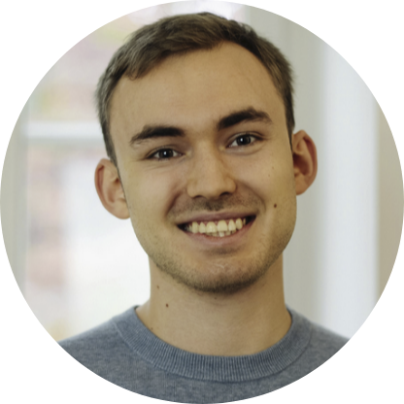
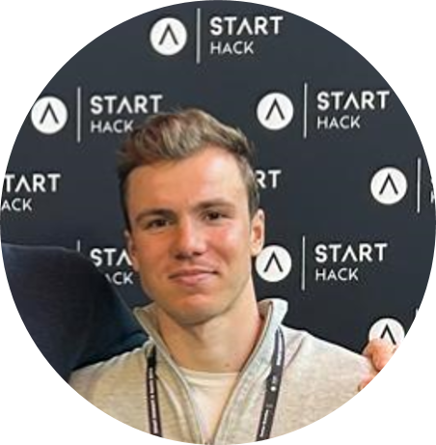
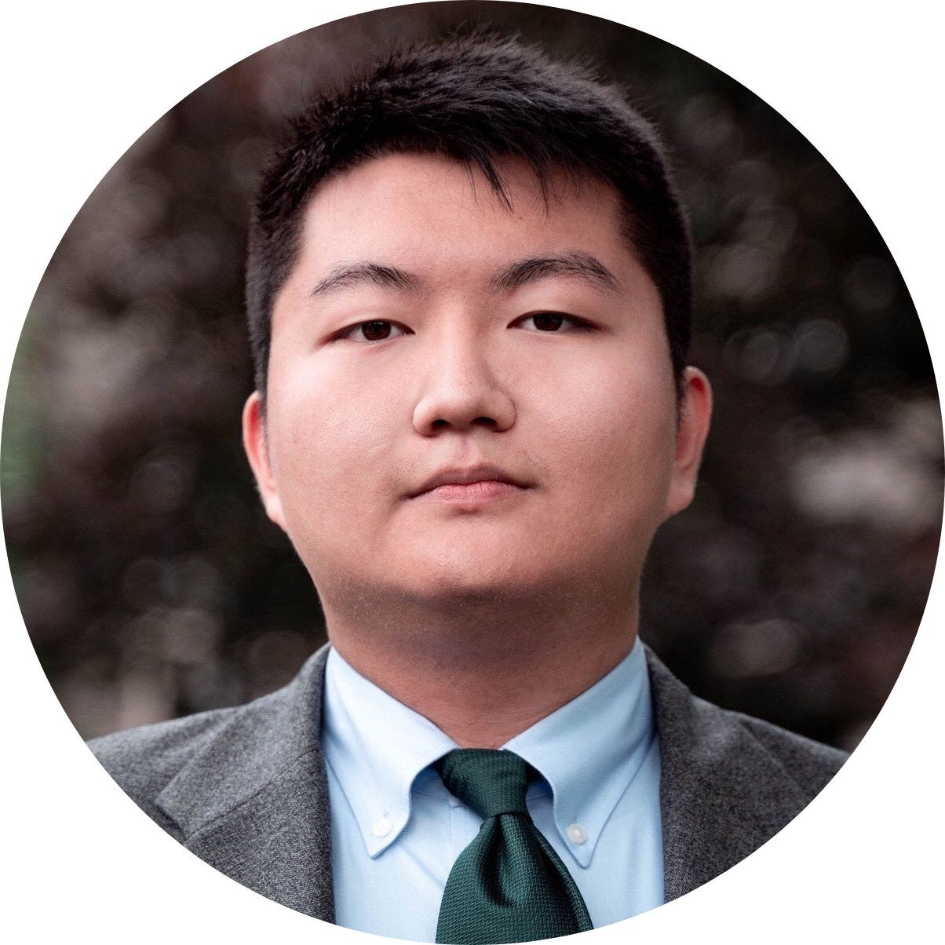

Team
Lenny Herold
B.Sc Business Mathematics
University of Mannheim
Niklas Wichter
M.Sc. Business Informatics
University of Mannheim
Jan Pluta
B.Sc Business Mathematics
University of Mannheim
Nick Xu
M.Sc. Data Science
KU Leuven
Noah Held
B.Sc Business Mathematics
University of Mannheim
Confidential • 36 • 23-Apr-25

